Slide 1
SURPRISE HOUSING DATA - PRICE PREDICTION
Report Summary
Submitted by:
SANTOSH H. HULBUTTI
Intern @ Flip Robo Technologies

Slide 2
The Problem Statement
Houses are one of the necessary needs of each and every person around the globe and therefore housing and real estate market is one of the markets which is one of the major contributors in the world’s economy. It is a very large market and there are various companies working in the domain.
It is required to build a model using Machine Learning in order to predict the actual value of the respective properties and decide whether to invest in them or not.
It is needed to understand, Which variables are important to predict the price of house? & How do these variables describe the price of the house

Slide 3
Steps & Assumptions
Data was given in two files, 1. Train set & 2. Test set. It was combined for Data Preprocessing.
Statistical summary of data was checked.
Missing values are imputed based on mode methos for categorical features & knn method for numerical features.
Features grouped based on data types vis., Numerical, continuous numerical, discrete numerical & categorical.
Following features are removed as they were highly skewed with 0 entries: BsmtFinSF2, LowQualFinSF, EnclosedPorch, 3SsnPorch, ScreenPorch, PoolArea, & MiscVal.
MSSubClass numbers are converted into Nominal categories.
MSold is converted in to cyclical number data, as moths are cyclical in nature.
Skewness is removed using Yeo-Johnson Power Transformer.
Outliers are removed using Z-score method. Data loss observed was 5.89%.
Multicoliinearity checked using seaborn heat map & VIF. GrLivArea is removed after checking multicollinearity.
Categorical features are encoded using pd.get_dummies() method.
Standard scaling is applied on the entire train & test data. & original Test Set data was separated.
We used train_test_split to split Train data for machine learning.

Slide 4
EDA Steps & Visualizations
Plots used for Data Visualization:
Distribution plots
Scatter plots
Reg plots
Count plots
Bar plots
Swarm plots
Heatmaps
The Data Visualization was done for:
Target variable (Sale Price)
Continuous Numerical Data
Discrete Numerical data
Categorical Features

Slide 5
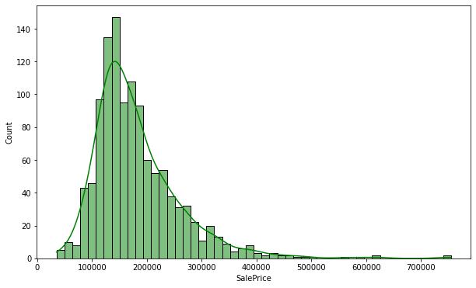
Target variable (Sale Price)
The Sale Price feature has right skewed distribution in which most Sales are between 80K and 340K.

Slide 6
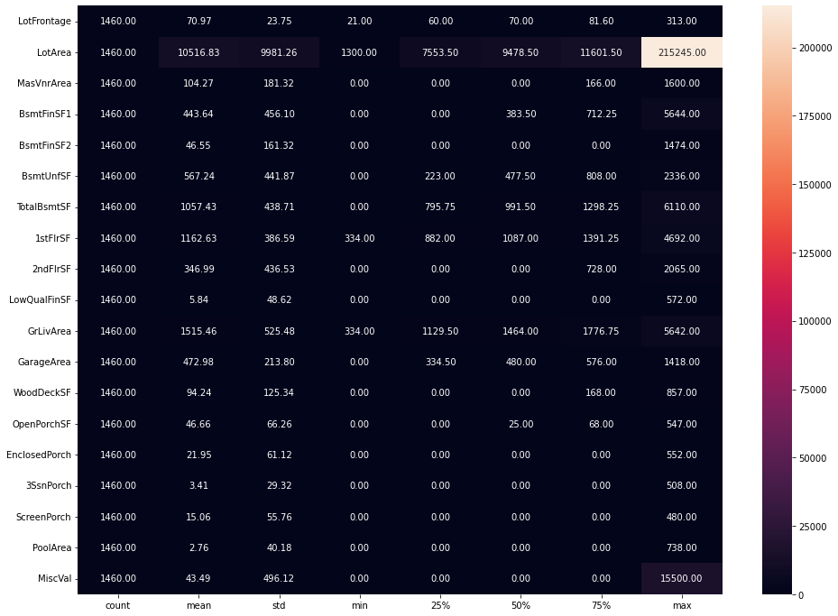
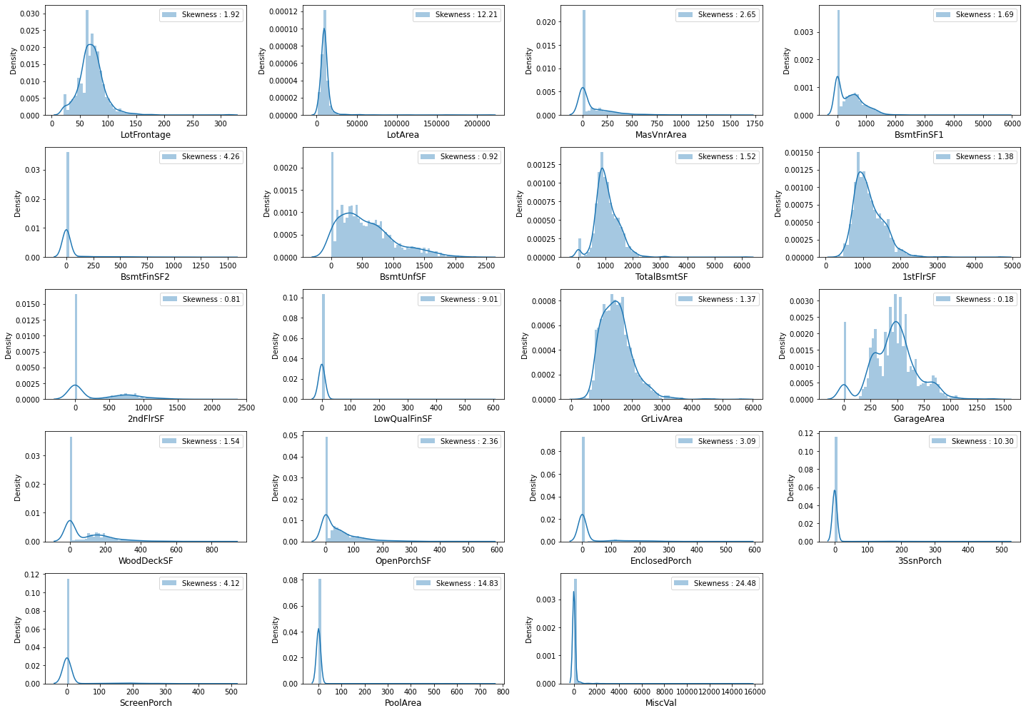
Continuous Numerical Data
Some of the features were highly skewed due to presence of 0 entries, outliers were also present.
Some features were having normal distribution after removing skewness & outliers
We removed features with high skewness.

Slide 7
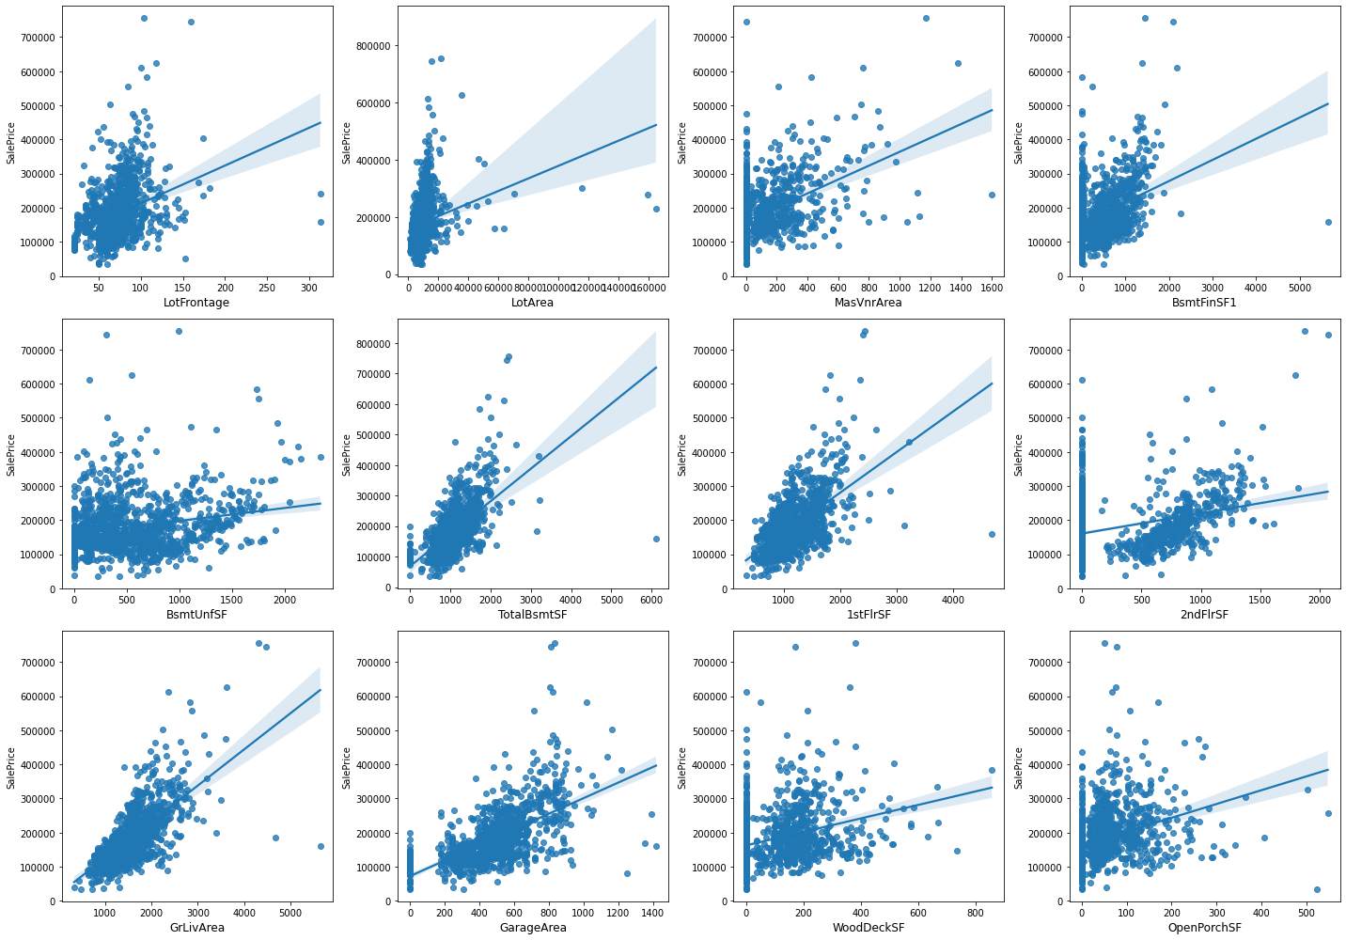
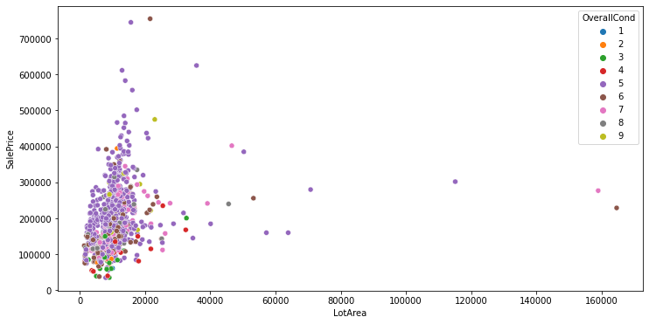
Continuous Numerical Data
Relation of continuous features with Target variable
Higher the area, higher the price. hence linear positive relation between Area features & Sale price.
Unfinished basement has no relation with Sale price
Houses with garages - higher the price.
All of the feature with minimum skewness were showing linear relation with target variable Sale Price.

Slide 8
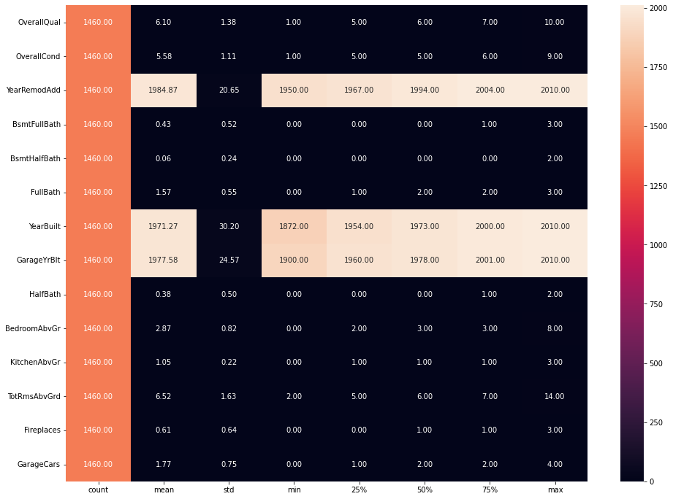
Discrete Numerical data
We see most of the entries as 0, which means no such type of features in corresponding house.
Oldest house built is in 1872, & newest being in 2010.
Oldest modification year was 1950, & recent modification year was 2010.
50% & 75% quantile values from heat maps indicate skewness & outliers presence.

Slide 9
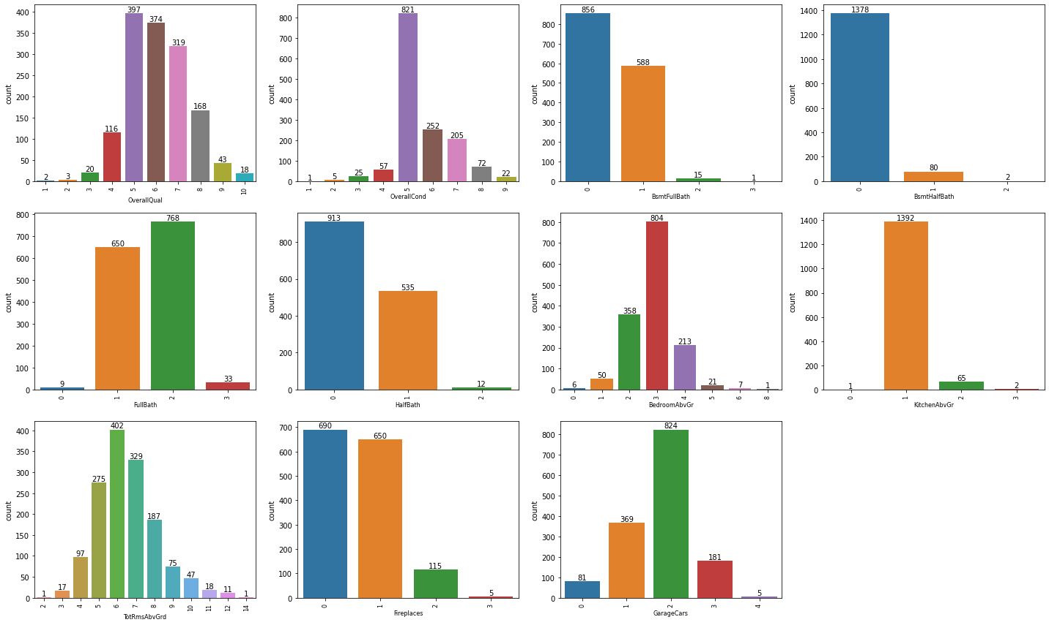
Discrete Numerical data
Relation of Discrete features with Target variable
Higher the quality, higher the price. hence linear positive relation between Quality features & Sale price.
Kitchen above ground & Over all condition showed negative relation with Sale price.
More rooms mean higher the price.
5, 6, 7 & 8 are the most common ratings given for Overall Condition & Quality.
856 units have no basement with full bath feature, 588 houses have 1 full bath in basement.
82 houses had half baths in basement area.
There were 1469 houses with kitchen above ground, 1442 houses with more than 4 rooms above ground.

Slide 10
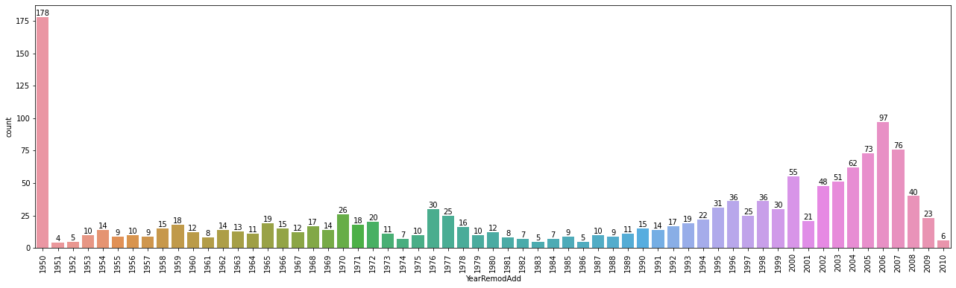
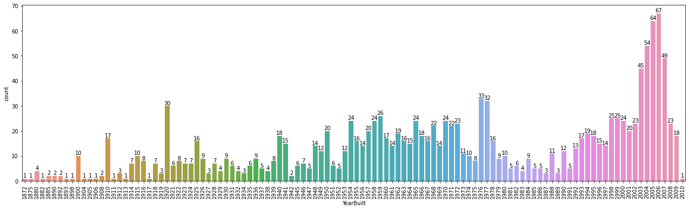
Discrete Numerical data
Most of the Hoses were modified recently.
Most of the houses were built in the year 1940 to 1980 & 1990 to 2010.

Slide 11
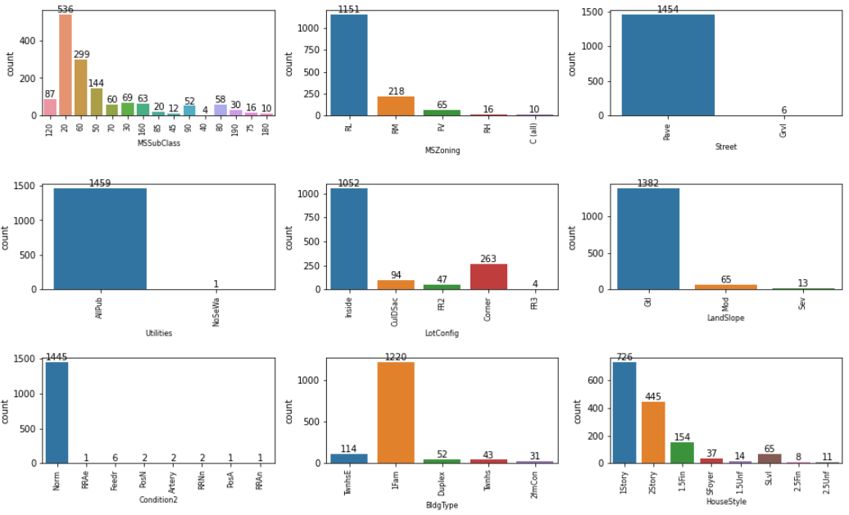
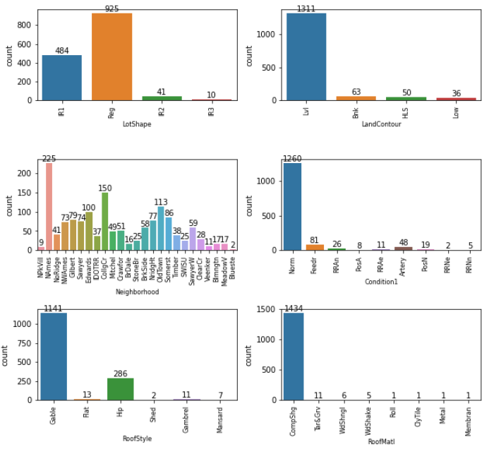
Categorical Features
Feature | Most occurring Entries
MSSubClass | 20, 50 & 60
MSZoning | Residential Low Density
Street | Paved
LotShape | Regular
LandContour | Near Flat/Level
Feature | Most occurring Entries
Utilities | AllPublic Utilities
LotConfig | Inside
Landslope | Gentle slope
Neighborhood | NWAmes
Condition1 | Normal
Feature | Most occurring Entries
Condition2 | Normal
BldgType | Single-family Detached
HouseStyle | 1Story, 2Story
RoofStyle | Gable
RoofMaterial | Standard (Comp) Shingle

Slide 12
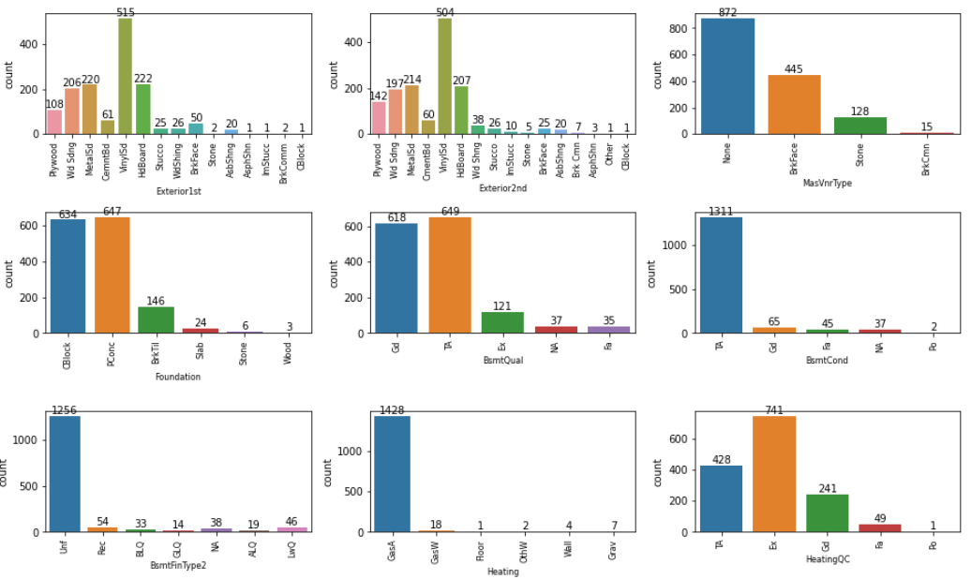
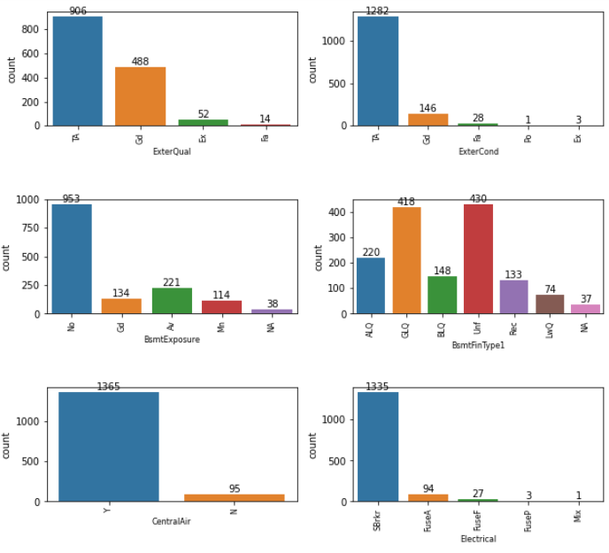
Categorical Features
Feature | Most occurring Entries
Exterior1st | Vinyl Siding
Exterior2nd | Vinyl Siding
MasVnrType | None
ExterQual | Good & Average/Typical
ExterCond | Average/Typical
Feature | Most occurring Entries
Foundation | Cinder Block & Poured Concrete
BsmtQual | Good & Typical
BsmtCond | Typical
BsmtExposure | No Exposure
BsmtFinType1 | Unfinished & Good Living Quarters
Feature | Most occurring Entries
BsmtFinType2 | Unfinished
Heating | Gas forced warm air furnace
HeatingQC | Excellent
CentralAir | Yes
Electrical | Standard Circuit Breakers & Romex

Slide 13
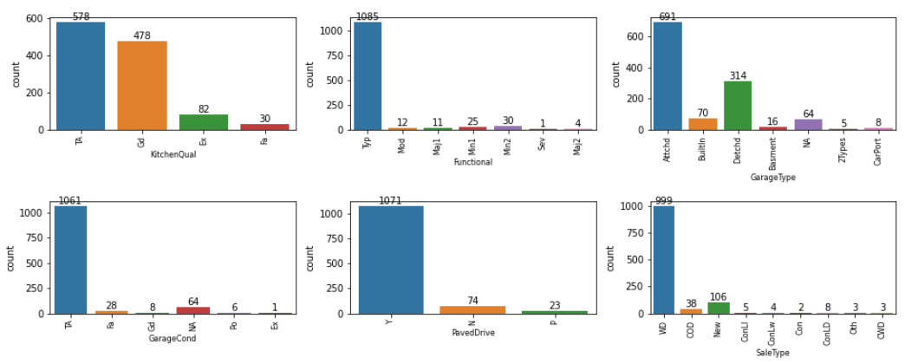
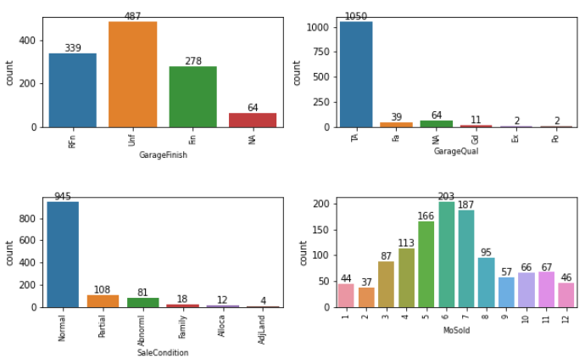
Categorical Features
Feature | Most occurring Entries
KitchenQual | Good & Typical/Average
Functional | Typical Functionality
GarageType | Attached to home
GarageFinish | Unfinished
GarageQual | Average/Typical
Feature | Most occurring Entries
GarageCond | Typical/Average
PavedDrive | Paved
SaleType | Warranty Deed - Conventional
SaleCondition | Normal Sale

Slide 14
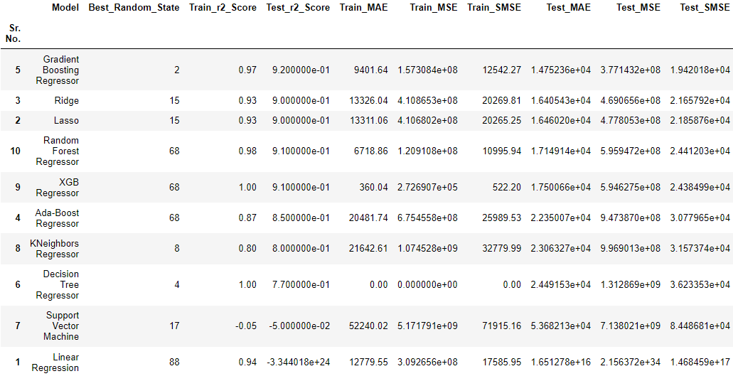
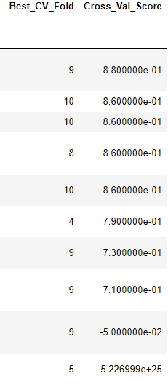
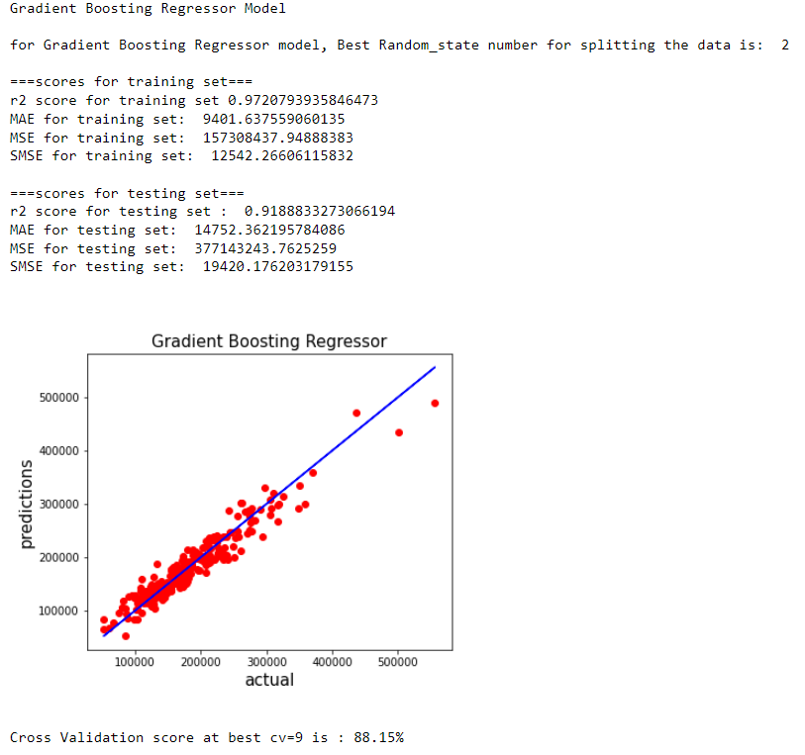
Finalized Model
We selected Gradient Boosting Regressor as our ML model for the reason stated afore:
Highest Cross validation score.
Highest R2 score obtained on Test set.
minimum mean absolute error amongst all the models.

Slide 15
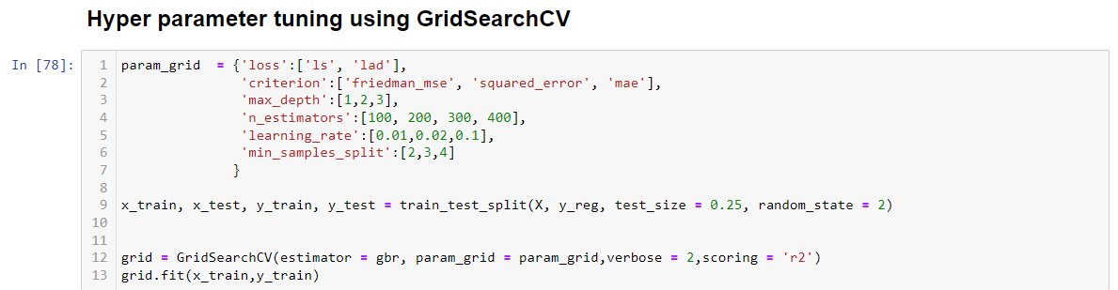
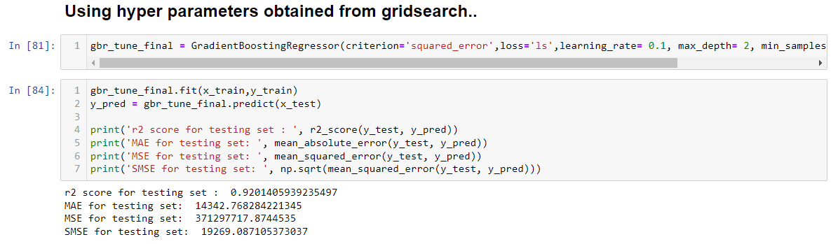
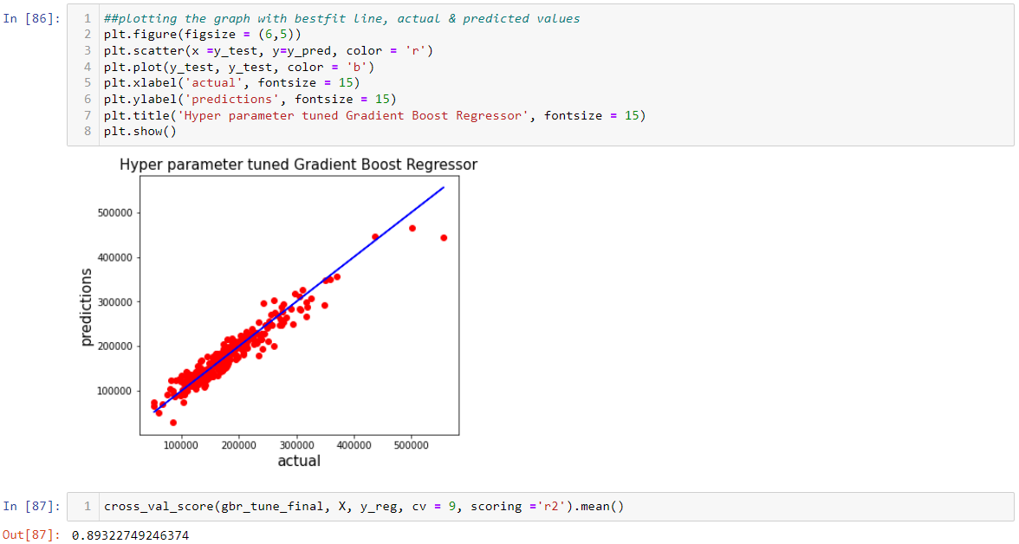
Finalized Model
After Selecting th ML model, We ran Grid Search CV to find out best hyperparameter for our model to increase accuracy/performance of our model.
We can see from the images that our R2 Score & Cross validation scores are increased after tuning the hyperparameters.

Slide 16
Conclusion
Outcome of this project is a Machine Learning model which can predict house price in Australia. This model can predict the Sale price with Mean Absolute Error of $14342 AUD. The accuracy of the predictions are 92%. It will help companies to get best possible properties for as per their clients requirements.
Most of the features have Positive linear relation with Sale Price of the houses.

